Slide 1
EDS Mini Project
Group Members:
1.Ganesh jumade
2. Mansi kawade
3. Namrata dolas
4. Vishwanath laidwar

Slide 2
Introduction
1.Linear regression analysis is used to predict the value of a variable
based on the value of another variable. The variable you want to predict is called the dependent variable. The variable you are using to predict the other variable's value is called the independent variable.
2.Understanding linear regression is important because it provides a scientific calculation for identifying and predicting future outcomes. The ability to find predictions and evaluate them can help provide benefits to many businesses and individuals, like optimized operations and detailed research materials.

Slide 3
Motivation
1) Linear regression serves as a foundation for several statistical procedures, either as special cases or close approximations. We came to know about this procedures.
2) Understanding Data Patterns: By working on a classification or clustering project, you can gain insights into the underlying patterns and relationships within the dataset.
3) Practical Application: Classification and clustering techniques are widely used in various fields, including finance, marketing, healthcare, and more.

Slide 4
DETAILS OF DATASET
Name : Blood Group
No. of people : 23
No. of Columns : 4
No. of Blood Group : 4

Slide 5
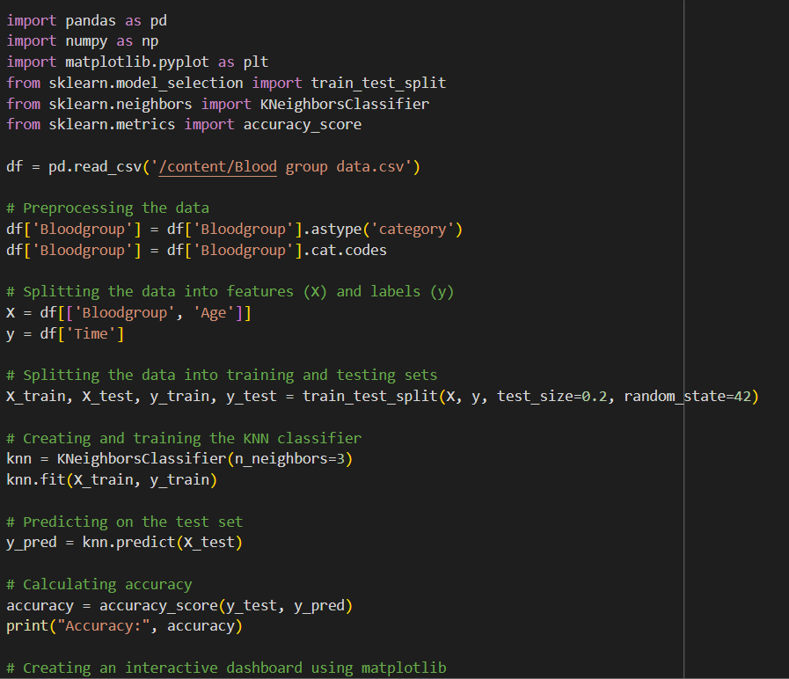
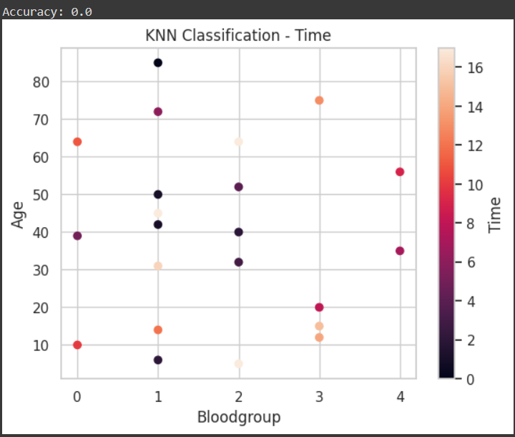
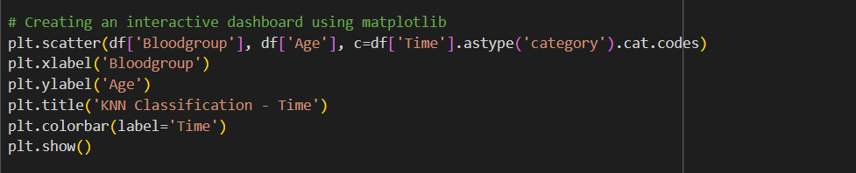
KNN Classification

Slide 6
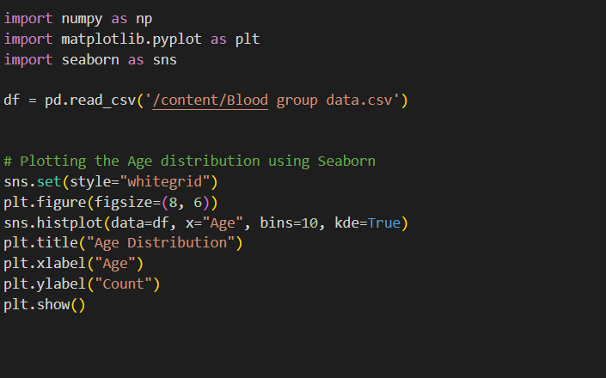
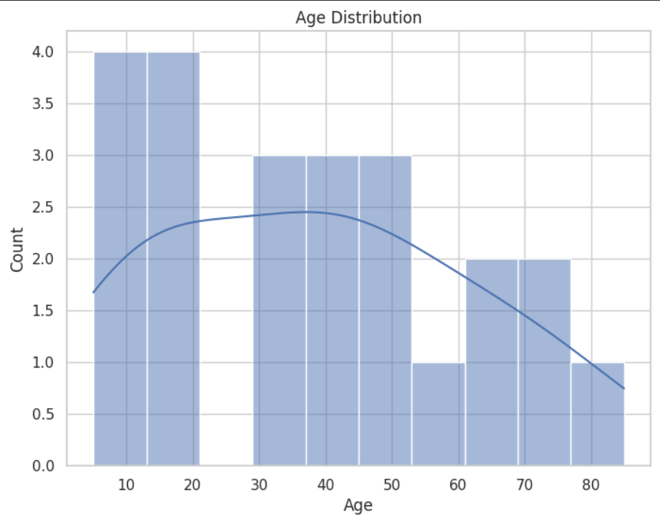
SEABORN

Slide 7
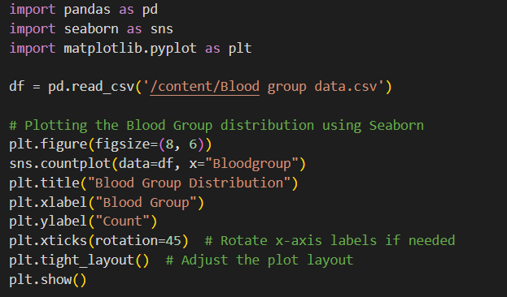
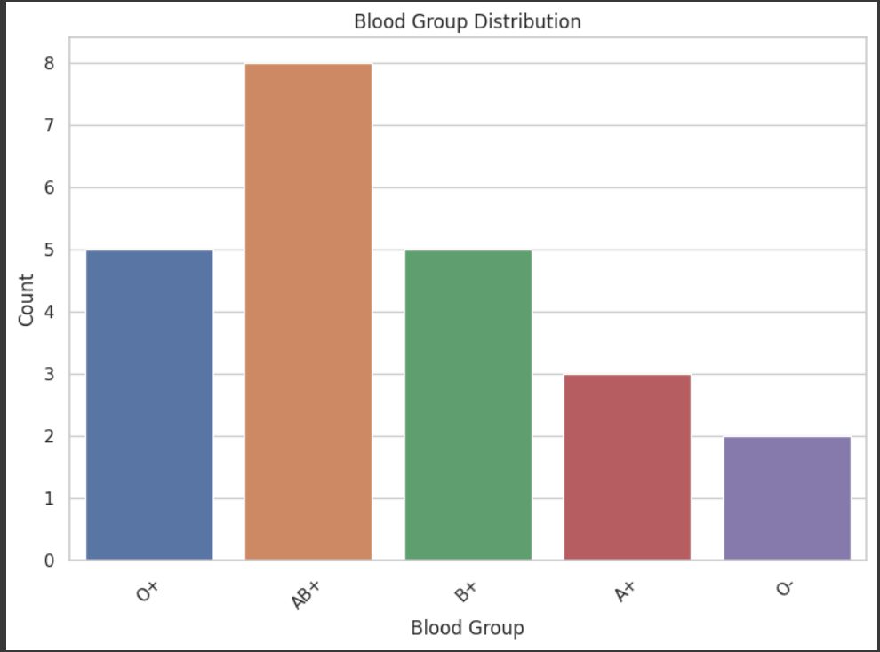
Distribution with Bargraph

Slide 8
CONLUSION
Cluster Separation: The K-Means algorithm has successfully separated the data points into distinct clusters based on their similarity in feature space.
Cluster Interpretation: The interpretation of each cluster depends on the context and the meaning of the features used.

Slide 9
THANK YOU
Guided By : Madhavi Nimkar

